Slide 1
Introduction to Testing
Dr. Durga Prasad Mohapatra
Professor
Department Of CSE
NIT, Rourkela.

Slide 2
Defect Reduction Techniques
Review
Testing
Formal verification
Development process
Systematic methodologies

Slide 3
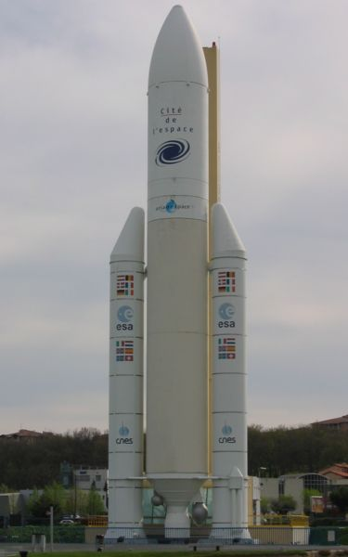
Why Test?
Ariane 5 rocket self-destructed 37 seconds after launch
Reason: A control software bug that went undetected
Conversion from 64-bit floating point to 16-bit signed integer value had caused an exception
The floating point number was larger than 32767
Efficiency considerations had led to the disabling of the exception handler.
Total Cost: over $1 billion

Slide 4
How Do You Test a Program?
Input test data to the program.
Observe the output:
Check if the program behaved as expected.

Slide 5
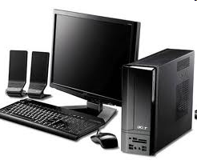


How Do You Test a Program?

Slide 6
How Do You Test a Program?
If the program does not behave as expected:
Note the conditions under which it failed.
Later debug and correct.

Slide 7
What’s So Hard About Testing ?
Consider int proc1(int x, int y)
Assuming a 64 bit computer
Input space = 2¹²⁸
Assuming it takes 10secs to key-in an integer pair
It would take about a billion years to enter all possible values!
Automatic testing has its own problems!
Notes:
(But, can think about doing this many tests today)

Slide 8
Testing Facts
Consumes largest effort among all phases
Largest manpower among all other development roles
Implies more job opportunities
About 50% development effort
But 10% of development time?
How?

Slide 9
Testing Facts
Testing is getting more complex and sophisticated every year.
Larger and more complex programs
Newer programming paradigms

Slide 10
Overview of Testing Activities
Test Suite Design
Run test cases and observe results to detect failures.
Debug to locate errors
Correct errors.

Slide 11
Error, Faults, and Failures
A failure is a manifestation of an error (also defect or bug).
Mere presence of an error may not lead to a failure.

Slide 12
Pesticide Effect
Errors that escape a fault detection technique:
Can not be detected by further applications of that technique.

Slide 13
Pesticide Effect
Assume we use 4 fault detection techniques and 1000 bugs:
Each detects only 70% bugs
How many bugs would remain
1000*(0.3)⁴=81 bugs

Slide 14
Fault Model
Types of faults possible in a program.
Some types can be ruled out
Concurrency related-problems in a sequential program

Slide 15
Fault Model of an OO Program
OO Faults
Structural Faults
Algorithmic Faults
Procedural Faults
Traceability Faults
OO
Faults
Incorrect Result
Inadequate Performance

Slide 16
Hardware Fault-Model
Simple:
Stuck-at 0
Stuck-at 1
Open circuit
Short circuit
Simple ways to test the presence of each
Hardware testing is fault-based testing

Slide 17
Software Testing
Each test case typically tries to establish correct working of some functionality
Executes (covers) some program elements
For restricted types of faults, fault-based testing exists.

Slide 18
Test Cases and Test Suites
Test a software using a set of carefully designed test cases:
The set of all test cases is called the test suite

Slide 19
Test Cases and Test Suites
A test case is a triplet [I,S,O]
I is the data to be input to the system,
S is the state of the system at which the data will be input,
O is the expected output of the system.

Slide 20
Aim of Testing
The aim of testing is to identify all defects in a software product.
However, in practice even after thorough testing:
one cannot guarantee that the software is error-free.

Slide 21
Aim of Testing
The input data domain of most software products is very large:
it is not practical to test the software exhaustively with each input data value.

Slide 22
Aim of Testing
Testing does however expose many errors:
testing provides a practical way of reducing defects in a system
increases the users' confidence in a developed system.

Slide 23
Aim of Testing
Testing is an important development phase:
requires the maximum effort among all development phases.
In a typical development organization:
maximum number of software engineers can be found to be engaged in testing activities.

Slide 24
Aim of Testing
Many engineers have the wrong impression:
testing is a secondary activity
it is intellectually not as stimulating as the other development activities, etc.

Slide 25
Aim of Testing
Testing a software product is in fact:
as much challenging as initial development activities such as specification, design, and coding.
Also, testing involves a lot of creative thinking.

Slide 26
Levels of Testing
Software products are tested at three levels:
Unit testing
Integration testing
System testing

Slide 27
Unit testing
During unit testing, modules are tested in isolation:
If all modules were to be tested together:
it may not be easy to determine which module has the error.

Slide 28
Unit testing
Unit testing reduces debugging effort several folds.
Programmers carry out unit testing immediately after they complete the coding of a module.

Slide 29
Integration testing
After different modules of a system have been coded and unit tested:
modules are integrated in steps according to an integration plan
partially integrated system is tested at each integration step.

Slide 30
System Testing
System testing involves:
validating a fully developed system against its requirements.

Slide 31
Verification versus Validation
Verification is the process of determining:
Whether output of one phase of development conforms to its previous phase.
Validation is the process of determining:
Whether a fully developed system conforms to its SRS document.

Slide 32
Verification versus Validation
Verification is concerned with phase containment of errors,
Whereas the aim of validation is that the final product be error free.

Slide 33
Design of Test Cases
Exhaustive testing of any non-trivial system is impractical:
Input data domain is extremely large.
Design an optimal test suite:
Of reasonable size and
Uncovers as many errors as possible.

Slide 34
Design of Test Cases
If test cases are selected randomly:
Many test cases would not contribute to the significance of the test suite,
Would not detect errors not already being detected by other test cases in the suite.
Number of test cases in a randomly selected test suite:
Not an indication of effectiveness of testing.

Slide 35
Design of Test Cases
Testing a system using a large number of randomly selected test cases:
Does not mean that many errors in the system will be uncovered.
Consider following example:
Find the maximum of two integers x and y.

Slide 36
Design of Test Cases
The code has a simple programming error:
If (x>y) max = x; else max = x;
Test suite {(x=3,y=2);(x=2,y=3)} can detect the error,
A larger test suite {(x=3,y=2);(x=4,y=3); (x=5,y=1)} does not detect the error.

Slide 37
Design of Test Cases
Systematic approaches are required to design an optimal test suite:
Each test case in the suite should detect different errors.

Slide 38
Design of Test Cases
There are essentially three main approaches to design test cases:
Black-box approach
White-box (or glass-box) approach
Grey-box (or model based) approach

Slide 39
Black-Box Testing
Test cases are designed using only functional specification of the software:
Without any knowledge of the internal structure of the software.
For this reason, black-box testing is also known as functional testing.

Slide 40
Black-box Testing Techniques
There are many approaches to design black box test cases:
Equivalence class partitioning
Boundary value analysis
State table based testing
Decision table based testing
Cause-effect graph based testing
Orthogonal array testing
Positive-negative testing

Slide 41
White-box Testing
Designing white-box test cases:
Requires knowledge about the internal structure of software.
White-box testing is also called structural testing.

Slide 42
White-Box Testing Techniques
There exist several popular white-box testing methodologies:
Statement coverage
Branch coverage
Path coverage
Condition coverage
MC/DC coverage
Mutation testing
Data flow-based testing

Slide 43
Coverage-Based Testing Versus Fault-Based Testing
Idea behind coverage-based testing:
Design test cases so that certain program elements are executed (or covered).
Example: statement coverage, path coverage, etc.
Idea behind fault-based testing:
Design test cases that focus on discovering certain types of faults.
Example: Mutation testing.

Slide 44
Why Both BB and WB Testing?
Black-box
Impossible to write a test case for every possible set of inputs and outputs
Some code parts may not be reachable
Does not tell if extra functionality has been implemented.
White-box
Does not address the question of whether or not a program matches the specification
Does not tell you if all of the functionality has been implemented
Does not discover missing program logic

Slide 45
Grey Box / Model Based Testing
In grey box testing, test cases are designed from design documents / models, such as UML diagrams.
Grey-box testing is also called model based testing.
Mainly used for testing of O-O systems.

Slide 46
Summary
Discussed importance of testing and the basic concepts of testing.
Presented the levels of testing.
Unit testing
Integration testing
System testing
Discussed the fundamentals of black box testing, white box testing and grey box testing.

Slide 47
References
R. Mall, Fundamentals of Software Engineering, (Chapter – 10), Fifth Edition, PHI Learning Pvt. Ltd., 2018.

Slide 48
Thank You

